Slide 1
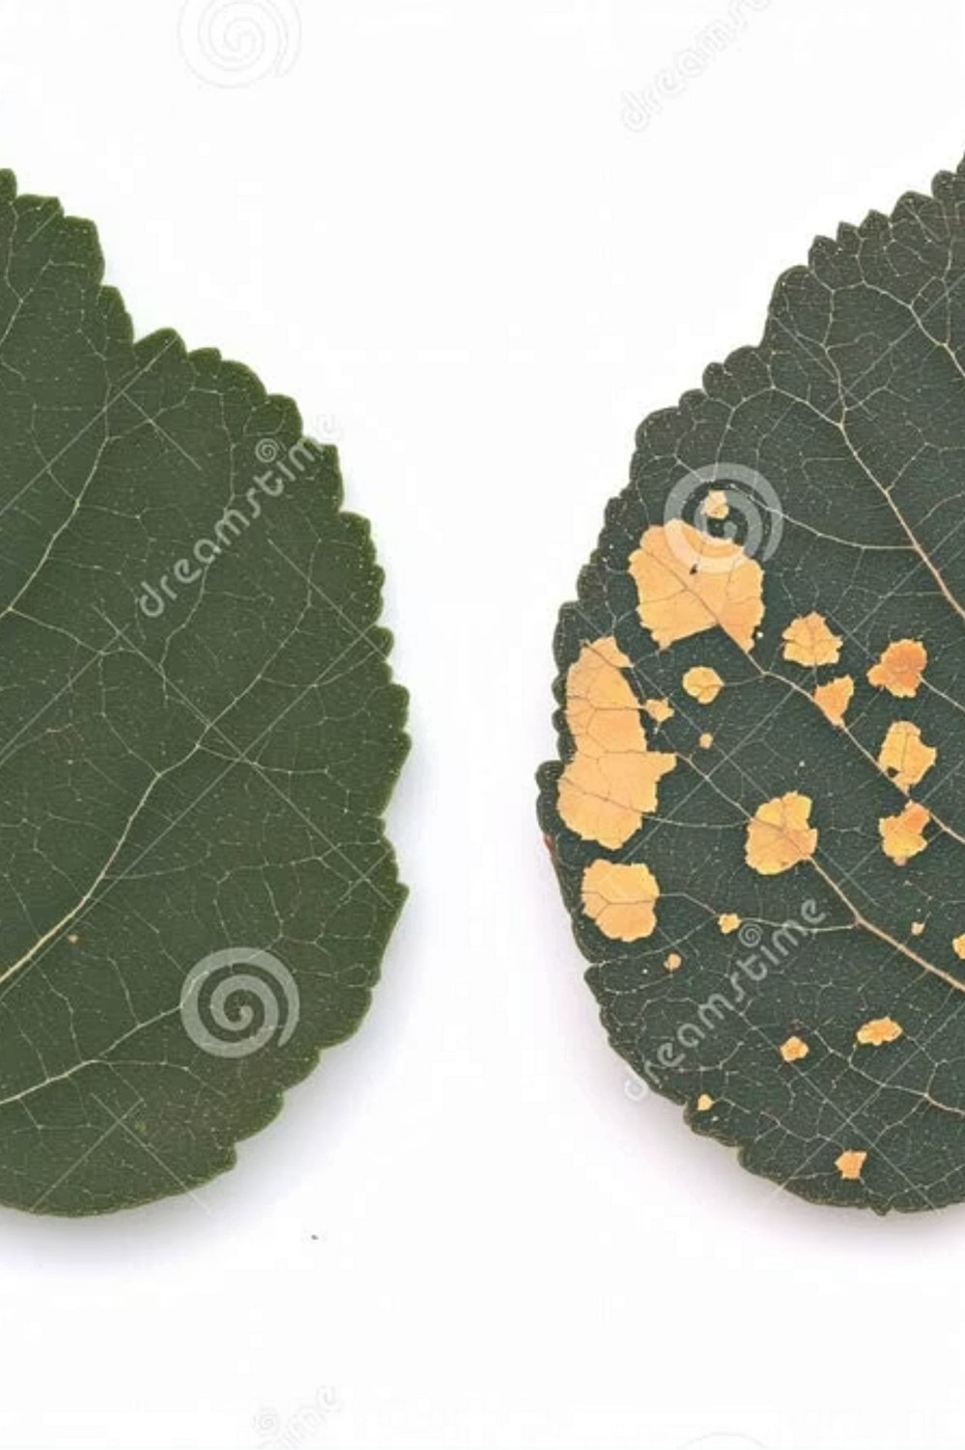
Development of a Mobile Application for Automated Plant Disease Detection Using Deep Learning on Leaf Images
Kirill Klimenko
Novosibirsk State Technical University, Russia
Research adviser: A. F. Aleinikov
Language adviser: A. A. Getman
Notes:
Good afternoon. I will present a study on deep-learning classification of plant diseases from leaf images, designed as the core of a mobile diagnostics app.

Slide 2
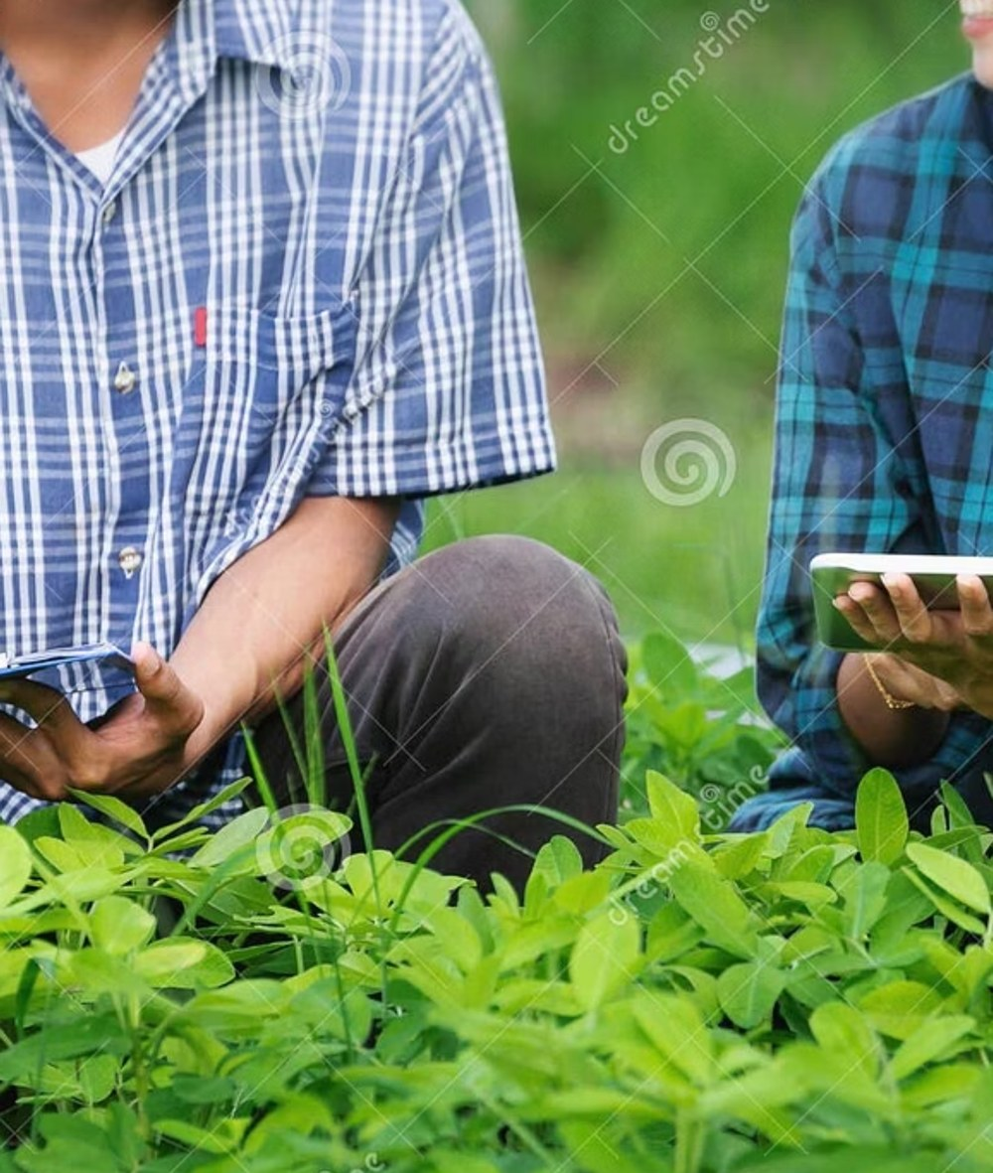



1. Introduction
Problem
Plant diseases cut yield and quality; visual diagnosis needs experience and is slow.
Challenge
Models trained on controlled images may fail in the field; mobile devices need small, fast models.
Aim
Evaluate a two-stage deep-learning pipeline for a mobile app: 6 crops, 20 diseases.
Notes:
Visual inspection of crops requires experience. Models trained on lab-like images often do not transfer to field photos, and phones limit model size and speed. Our aim: evaluate a two-stage classification pipeline.

Slide 3
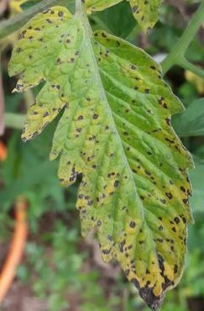
2. Materials and Methods — Dataset
PlantVillage dataset
54,306
38
14
images
classes
crops
Selected: 6 crops · 20 disease classes
Apple
Corn
Grape
Potato
Strawberry
Tomato
2 classes
3 classes
3 classes
2 classes
4 classes
6 classes
+ ~100 external photos per class · undersampling + augmentation
Example of an external field photo
Notes:
Source: PlantVillage, 54,306 images, 38 classes, 14 crops. We selected six crops with 20 disease categories. To reduce dependence on clean backgrounds, about 100 external photographs per class were added; imbalance was handled with undersampling and augmentation.

Slide 4
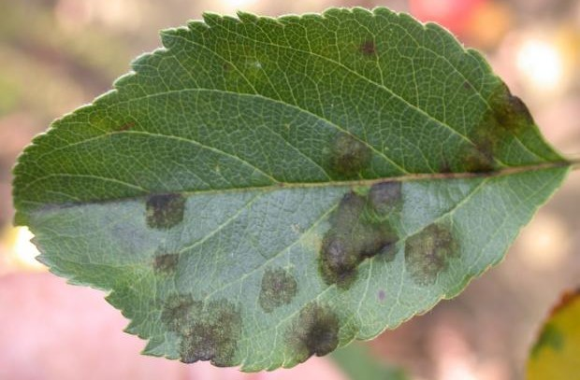
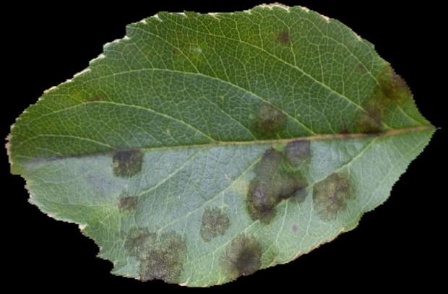
2. Materials and Methods — Diagnostic pipeline
Leaf image
Background removal
Crop selection by user
Binary classifier: Healthy / Diseased
Crop-specific disease classifier
U-Net, MobileNetV3Large encoder
if diseased
disease label
Input photo
Background removed, resized to 256 × 256 px
Notes:
Segmentation is only a preprocessing step: it removes the background and keeps the leaf. Then the user selects the crop, a binary classifier decides healthy vs diseased, and only for diseased leaves a crop-specific classifier names the disease. This keeps each classifier small and the workflow modular.

Slide 5
2. Materials and Methods — Models and training
Baseline: MobileNetV3Large
Compact architecture suited to mobile deployment; compared with the same head.
Head: Dense2 selected
2 ReLU layers (256 → 128), BN, L2, dropout; val. loss 0.1454 vs 0.1500 for Dense1.
Training setup
Adam · batch 32 · ≤ 30 epochs · 15% validation split · early stopping.
Notes:
Three backbones were compared with the same head on PlantVillage. EfficientNetV2B2 was marginally better than MobileNetV3Large, ResNet50V2 clearly worse. MobileNetV3Large was kept as the baseline for its mobile suitability. Dense2 head gave slightly lower validation loss.

Slide 6
3. Results — Binary classification (healthy / diseased)
96.88%
mean test accuracy
Best: Potato 99.0%
Lowest: Tomato 93.1%
Notes:
All six binary classifiers exceeded 93% test accuracy; mean 96.88%. Potato was best at 99.0%, tomato the lowest at 93.1%.

Slide 7
3. Results — Crop-specific disease classification
84.57%
mean test accuracy
Hardest crops
Strawberry 73.0% and tomato 70.0% — the next slide tests a stronger backbone
Notes:
Disease-level classification is harder: mean 84.57%. Potato, apple and corn are above 91%; strawberry and tomato are the weak spots.

Slide 8
3. Results — Stronger backbone for difficult crops
+7.1 pp
Strawberry: 73.0% → 80.1%
+5.5 pp
Tomato: 70.0% → 75.5%
But the cost is high
Model size 12 → 35 MB
Inference ≈ 2 s slower
Notes:
Replacing the backbone with EfficientNetV2B2 improved strawberry by 7.1 and tomato by 5.5 percentage points, but the model grew from about 12 to 35 MB and inference became about two seconds slower.

Slide 9
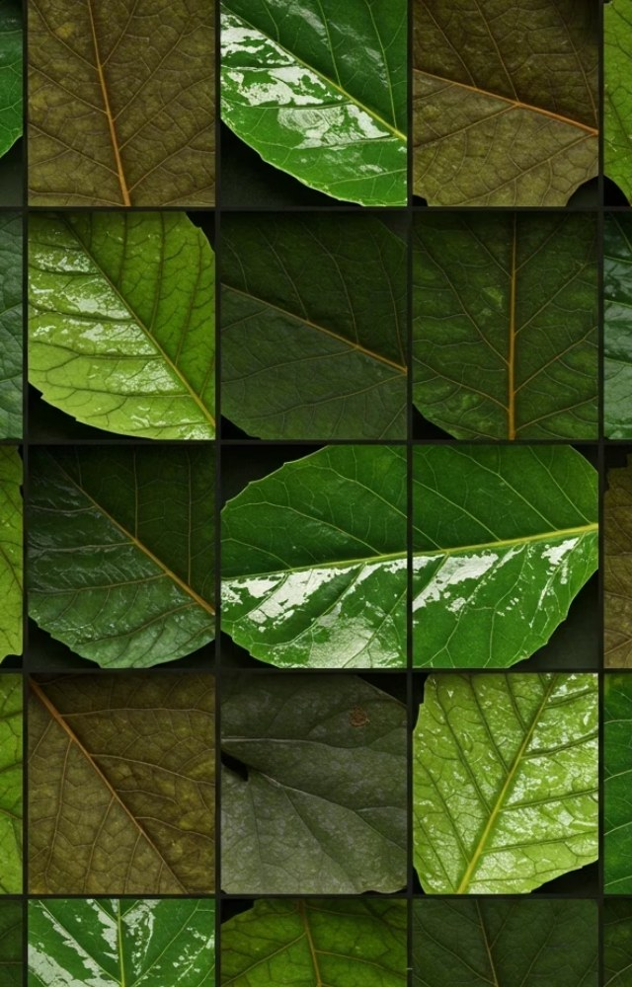



4. Discussion
Two stages work
Binary 96.88% vs disease-level 84.57%: telling similar diseases apart is the harder task.
Accuracy vs. efficiency
EfficientNetV2B2 helps on hard crops but is larger and slower; MobileNetV3Large stays the practical mobile baseline.
Limitations
PlantVillage is controlled (domain shift); only 6 crops and 20 classes; field testing is still needed.
Notes:
Splitting the task is effective. Tomato and strawberry are hardest, and class count alone does not explain it. EfficientNet trades size and speed for accuracy. PlantVillage images are controlled, so field testing is needed before deployment.

Slide 10
5. Conclusion
96.88%
84.57%
MobileNetV3Large
Mean accuracy of binary healthy / diseased classifiers
Mean accuracy of crop-specific disease classifiers
Best balance of quality and efficiency for mobile
Next: validate on diverse field photographs to assess real-world reliability
Notes:
A two-stage pipeline reaches 96.88% for healthy/diseased detection and 84.57% for disease classification. MobileNetV3Large offers the best balance for mobile use. The next step is validation on diverse field photographs. Thank you for your attention.

